Slide 1
Class
A class can be defined as a template/blueprint that describes the behavior/state that the object of its type support.

Slide 2
Object
Objects have states and behaviors. Example: A dog has states - color, name, breed as well as behaviors the tail, barking, eating.
An object is an instance of a class

Slide 3
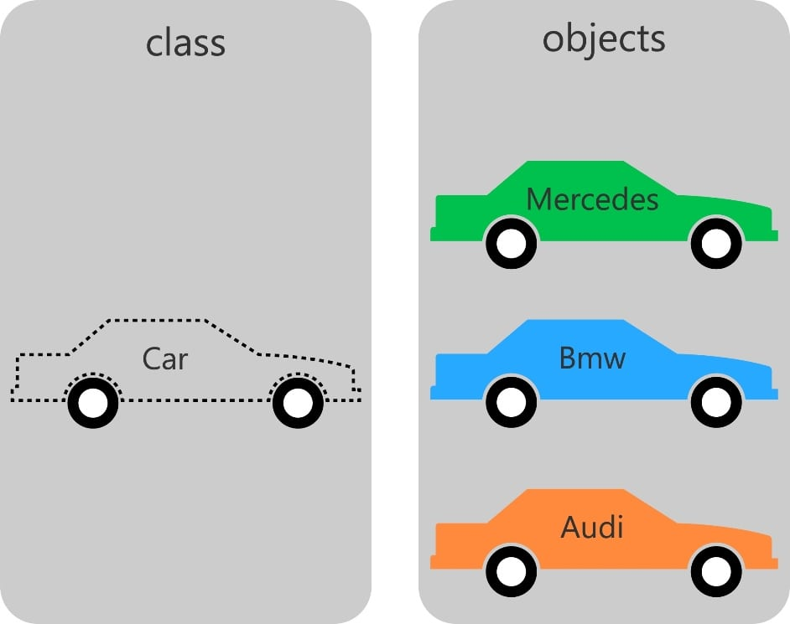

Slide 4
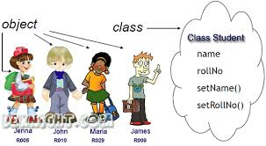

Slide 5
